Slide 1
Processing
CM1016 – Labs

Slide 2
Module Structure
Mondays
Lab (9-11) with Mark & Andrei
Lecture (1-2) with Andrei
Tutorial (2-3) with Andrei/Mark/Roger (check your group on Moodle!)

Slide 3
Module Structure
Mondays
Lab (9-11) with Mark & Andrei
Lecture (1-2) with Andrei
Tutorial (2-3) with Andrei/Mark/Roger (check your group on Moodle!)
Wednesdays
Lab (9-12) with Mike
Fridays
Lab (2-3) with Roger

Slide 4
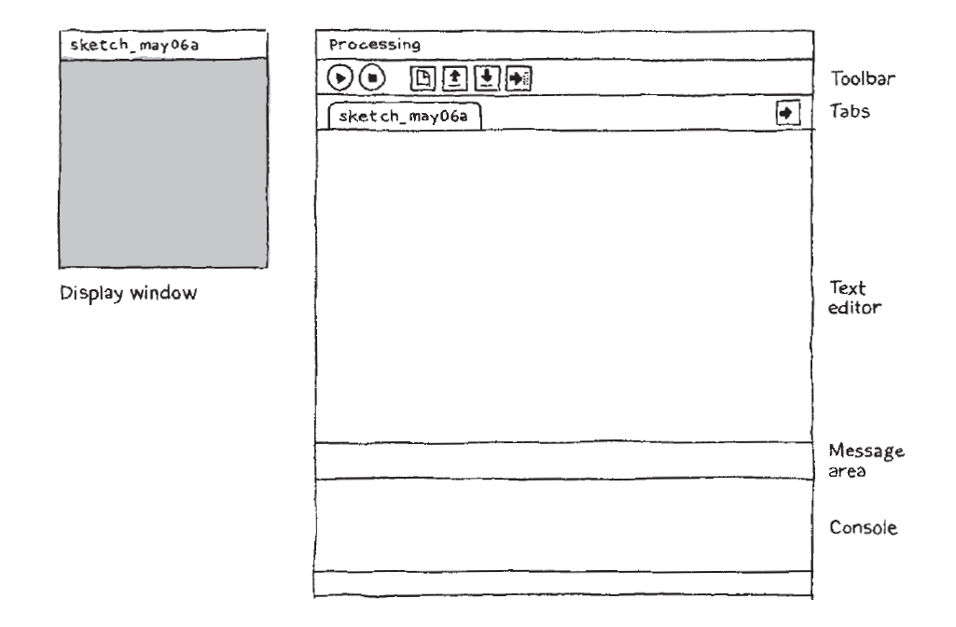
Processing

Slide 5
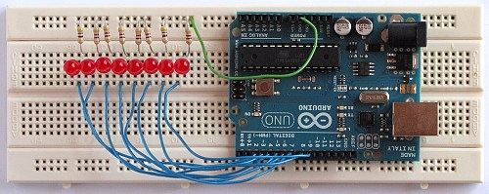
Arduino

Slide 6
Assessment
A team project near the end of the semester.
Further information on this later on.

Slide 7
General Info
We will be doing Processing for the first couple of weeks
Free download onto Win/Mac/Linux from processing.org
We will start learning about Arduino after that
Equipment provided by us

Slide 8
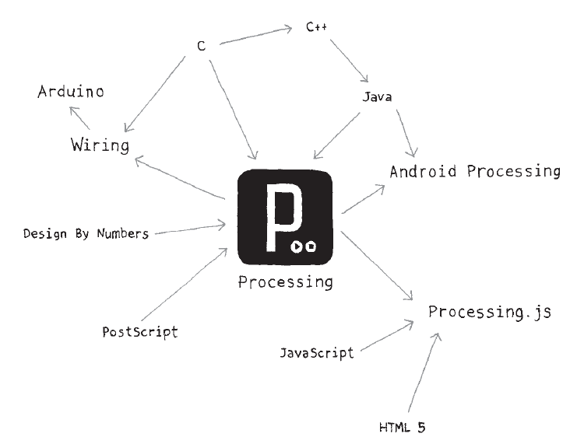

Slide 9
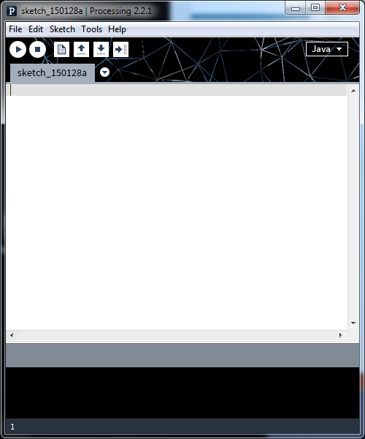

Slide 10
Processing Code Structure
There are two parts (or “methods”) to a program in Processing:
Code you put here runs once at the start of your program.
It is used to define initial values (e.g. screen size).
Code you put here runs continuously.
It is used to change the display of your program.

Slide 11
Before You Start
You need to set the size of the drawing window. We use the size(x, y) command as follows:
size(800, 600);
You can change the values to suit your project.
As we only need to define the screen size once, this code goes in the setup() method.

Slide 12
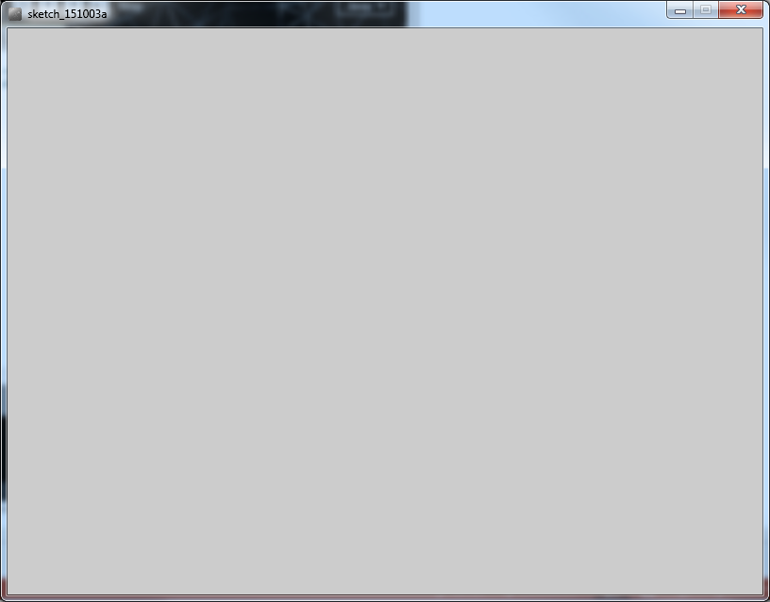

Slide 13
800px

Slide 14
800px
600px

Slide 15
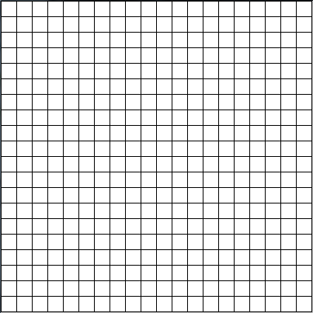

Slide 16
Co-ordinates in Processing
x
0 1 2 3 4 5 6 7 8 9 10 11 12 …
0123456789...
y

Slide 17
Co-ordinates and Positions
x
0 1 2 3 4 5 6 7 8 9 10 11 12 …
0123456789...
In Processing, the origin (x=0, y=0) is the upper-left corner of the display window, with co-ordinates increasing down and to the right.
y
Notes:
“Processing: A Handbook”

Slide 18
The Simplest Visual Element
point(x, y);
This function creates a point, typically the size of a pixel.
As we are drawing on the screen, this code goes in the draw() method.

Slide 19
The Simplest Visual Element
point(x, y);
This function creates a point, typically the size of a pixel.
point(0, 0);
point(0, 10);
point(5, 1);
Etc…
0 1 2 3 4 5 6 7 8 9 10 11 12 …
0123456789...

Slide 20
The Simplest Visual Element
point(x, y);
This function creates a point, typically the size of a pixel.
point(0, 0);
point(0, 10);
point(5, 1);
Etc…
0 1 2 3 4 5 6 7 8 9 10 11 12 …
0123456789...

Slide 21
The Simplest Visual Element
point(x, y);
This function creates a point, typically the size of a pixel.
point(0, 0);
point(0, 10);
point(5, 1);
Etc…
0 1 2 3 4 5 6 7 8 9 10 11 12 …
0123456789...

Slide 22
The Simplest Visual Element
point(x, y);
This function creates a point, typically the size of a pixel.
point(0, 0);
point(0, 10);
point(5, 1);
Etc…
0 1 2 3 4 5 6 7 8 9 10 11 12 …
0123456789...

Slide 23
Creating Lines
A line consists of two points, joined together.
line(x1, y1, x2, y2);
first point second point

Slide 24
Creating Lines
A line consists of two points, joined together.
line(0, 0, 10, 10);
0 1 2 3 4 5 6 7 8 9 10 11 12 …
0123456789...

Slide 25
Creating Lines
A line consists of two points, joined together.
line(0, 0, 10, 10);
0 1 2 3 4 5 6 7 8 9 10 11 12 …
0123456789...

Slide 26
Creating Lines
A line consists of two points, joined together.
line(0, 0, 10, 10);
0 1 2 3 4 5 6 7 8 9 10 11 12 …
0123456789...

Slide 27
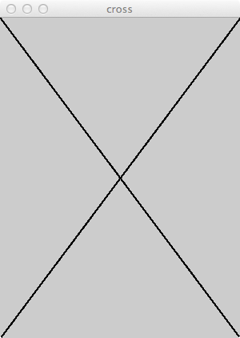
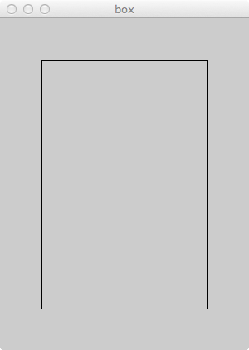
Task 1
Start with a window of size 300 x 400, and draw the following.

Slide 28
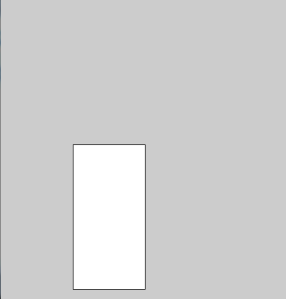
Primitive Shapes
These shapes are pre-specified in Processing, and can be created by filling in the values.
Further information can be found on processing.org/reference
rect(x, y, width, height);
ellipse(x, y, width, height);
x,y is the point around which each shape is drawn.
Top-left of the rectangle
Centre of the ellipse
x=100, y=200

Slide 29
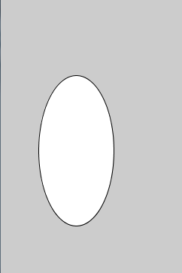
Primitive Shapes
These shapes are pre-specified in Processing, and can be created by filling in the values.
Further information can be found on processing.org/reference
rect(x, y, width, height);
ellipse(x, y, width, height);
x,y is the point around which each shape is drawn.
Top-left of the rectangle
Centre of the ellipse
x=100, y=200

Slide 30
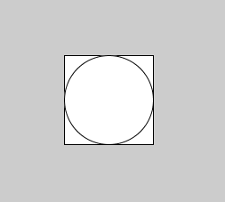
Task 2
Draw some rectangles and ellipses in your program.
How would you draw a square, or a circle?

Slide 31
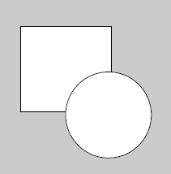
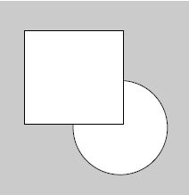
Drawing Order
The order in which shapes are drawn in the code defines which overlapping shapes appear on top of each other in the display window.
For example:
rect(15, 15, 50, 50); ellipse(60, 60, 45, 45);
ellipse(60, 60, 45, 45); rect(15, 15, 50, 50);

Slide 32
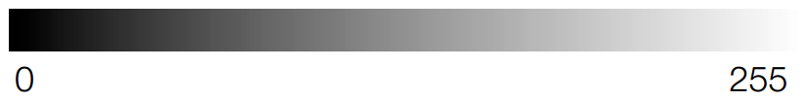
256 Shades of Grey
We can use the fill() command to colour the inside of the shapes.
fill(0); //Black
fill(255); //White

Slide 33

Drawing Order
Ordering is important when considering which shapes are coloured.
For example:
rect(15, 15, 50, 50); fill(0);
fill(0); ellipse(60, 60, 45, 45);
ellipse(60, 60, 45, 45); rect(15, 15, 50, 50);

Slide 34
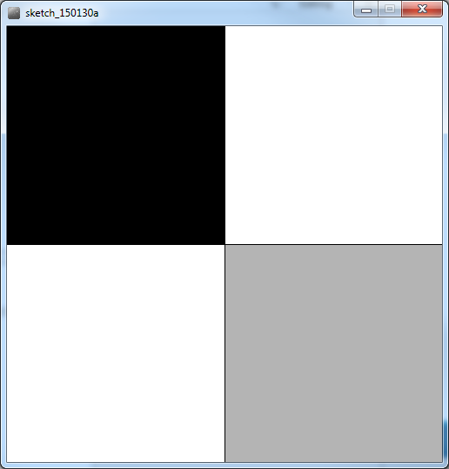
Task 3
Draw the following. What’s the minimum amount of lines you can code this in?

Slide 35

Drawing Order
The fill is applied to all the code that follows it.

Slide 36
Drawing Order
The fill is applied to all the code that follows it.

Slide 37
Drawing Order
The fill is applied to all the code that follows it.

Slide 38
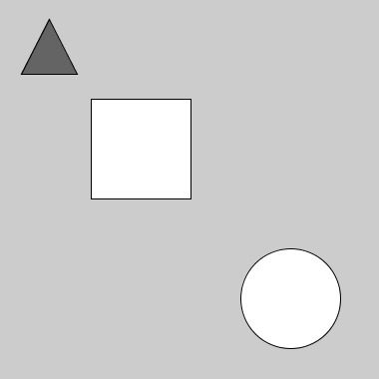
Drawing Order
The fill is applied to all the code that follows it.

Slide 39
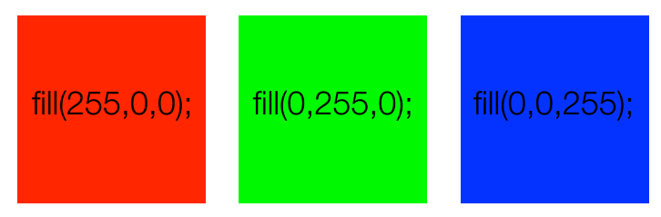
Colour
The fill() command can be used with three parameters to denote an RGB colour value:
fill(r, g, b);

Slide 40
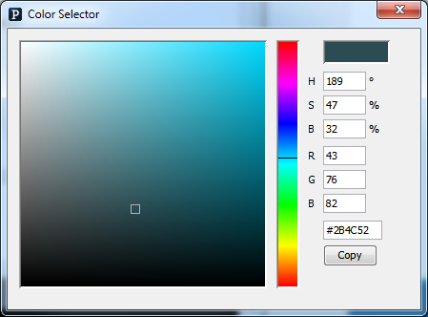
Mixing Colours
To find out the RGB colour value of a specific colour, use the Processing Colour Selector
(Tools > Colour Selector)

Slide 41



Task 4
Draw an Android or an Apple logo.
Add some colour.
Can you give your shape some rounded edges? Look on processing.org/reference for ideas.

Slide 42
Task 5
Draw a face. Use circles for the eyes, and rectangles for the nose and mouth.
Put it in the centre of the window.
Now, change the window size. Can you write code so that the face is always centred, no matter what the window size is?
(Hint – use the reference library at processing.org/reference).

Slide 43
By next week, you should be familiar enough with drawing and colouring basic shapes in Processing.
Remember: you have various resources for support:
- processing.org/reference
- YouTube tutorials
- Us!

